Slide 1
Information Session
Achieving the CPA Designation
2016/2017 Challenge Exams and CFE

Slide 2
Agenda
Part 1 - CPA Program
Session Purpose
Description of CPA Program
Summary of CPA Program – Capstone 1, Capstone 2, CFE
Decision Tree – Lays out Paths to Achieve CPA Designation Available to Ontario Students
Deciding which Path to Take
6) Challenge/Module Exams – Blue Prints for Each Exam
7) Timing of Challenge/Module Exams
8) Preparing for the Challenge Exams and Deciding When to Write
Part 2 – PASS Program
1) Who is PASS?
2) What PASS has to Offer – Courses and Resources Available for Challenge /Module Exam , CFE Courses and Resources for Students taking a Diploma/Accredited Program
3) Registration Information

Slide 3
Session Purpose
Purpose of the session is to acquaint you with the exams that you will be writing to achieve your CPA designation and discuss what is involved in preparing for these exams
With that knowledge you will be able to make an informed decision as to how and when to attack the exams
Will also acquaint you with the PASS program that has been designed to help students successfully complete the CPA program
With good knowledge of what the exams involve and how to prepare we hope to relieve any tension you are feeling

Slide 4
PART 1 – CPA PROGRAM
Description of CPA Program
4

Slide 5
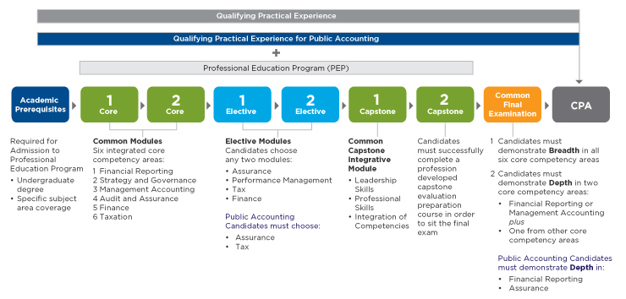
DIAGRAM OF CPA PROFESSIONAL
EDUCATION PROGRAM

Slide 6
CPA Qualification System Summary of Program
Education program normally takes 2 years from start to finish
Program can however be completed in Ontario in only 1 year if:
1) You have your 51 credit hours; and
2) You have at least a 70% average in the required courses, and
by writing “Challenge Exams” rather than participating in the 2 Core and 2 Elective modules

Slide 7
CPA Qualification System Summary of Program (cont.)
Challenge exams offered only for Tax and Assurance Electives – if you wish to take other Electives would need to do the program over 2 years and take the respective Elective Modules
After passing Challenge Exams you would go directly to Capstone Integrative Module (Capstone 1) and then the Capstone Evaluation Preparation (Capstone 2)
In some universities possible to do Accredited Program (Diploma Program) in place of Modules/Capstones
Final step is writing and passing 2017 CFE

Slide 8
Capstone 1
Main focus of Capstone 1 is business case which students work on as a group
Capstone 1 also prepares candidates for the Common Final Examination (CFE), particularly Day 1, which will draw on both the content and the skills developed in Capstone 1
Key aspects of Capstone 1 include:
A significant written report that simulates a report to a board of directors or team of senior executives
An oral team presentation that simulates a presentation to a board or team of senior executives
Structured time for questions and answers that simulates a question period from a board or team of senior executives

Slide 9
Capstone 1 (continued)
Will start with a two day weekend workshop which will provide an opportunity for team members to meet each other, develop team agreements, practice presentation skills, and develop an action plan for completing the learning activities required during the module
Should require between 10-15 hours of structured learning time per week for each candidate
Need to submit report and make presentation as a group
Pass rate not disclosed but assumed very high – possible to fail as a group or individual student could fail if work not performed

Slide 10
Capstone 2
Capstone 2 has three primary objectives:
Continue the development of candidates’ enabling competencies, particularly their communication and self-management competencies
Prepare candidates for all three days of the Common Final Examination (CFE)
Continue the development of candidates’ integration of technical competency areas
No Examination at the end of Capstone 2 - i.e. Everyone passes

Slide 11
Capstone 2 (continued)
Start with a 2 day weekend workshop - before that write 1 “multi” case
Workshop will teach students how to debrief, analyze response
Over the course of 7 weeks will require 10 – 15 structured hours a week (say max 20)
Limited opportunity to write practice cases; some cases marked; cases debriefed in online webinars

Slide 12
Description of CFE
CFE is 3 days long
Day 1 – Based on Capstone 1
Day 2 – Comp
Day 3 – Multis
CFE covers the same 6 Competencies covered in Core modules:
1) Audit & Assurance
2) Financial Reporting
3) Management Accounting
4) Finance
5) Taxation
6) Strategy and Governance

Slide 13
Description of CFE (continued)
Required to achieve “Depth” in 2 areas on the CFE and would need to only achieve “Breadth” in the others areas
For CPA External Audit, would need to achieve depth in the 2 areas, Assurance and Financial Reporting
Otherwise need to achieve depth in either Financial Reporting or Management Accounting plus any one of the other 4 competencies, Assurance, Taxation, Performance Management or Finance
Would make a choice of one of the four depth areas before the CFE
Roll on the elective comp on Day 2 of CFE will differ depending on depth area chosen – also different information will be provided depending on depth area chosen

Slide 14
Will not be relevant to most students given 2015 date

Slide 15
Deciding which Path to Take
Advantages of Challenge Exams over Taking the Modules
Less Costly
The Modules are far more costly than simply writing the challenge exams and taking a prep course

Slide 16
Deciding which Path to Take (continued)
(2) More Study Time
Modules take up a significant amount of time, more than a prep course
(3) Stronger Technical
Many students who take the modules complain that the technical is not at a high enough level and want to supplement it

Slide 17
Deciding which Path to Take (continued)
(4) Specifically Designed to Prepare Students for the Challenge Exams
Modules vary in quality and instructors have little knowledge of the Challenge Exams
(5) Same Chance of Passing
There appears to be no evidence that students do better on the exams when coming from the Modules
With proper preparation for the Challenge Exams, one should be successful (pass rates are not disclosed, but appear very high)

Slide 18
Deciding which Path to Take (continued)
Advantages of Challenge Exams over Diploma/Accredited Programs
Less Costly
Diploma/Accredited programs are far more costly than simply writing the challenge exams and taking a prep course

Slide 19
Deciding which Path to Take (continued)
(2) More Study Time
Diploma/Accredited programs take up a significant amount of time
(3) More Up to Date on Technical
Writing the 4 challenge exams forces students to beef up their technical
Anecdotal evidence from many Diploma/Accredited programs is that students feel their technical is inadequate for the CFE
There could be a large time gap between when one does the Diploma/Accredited program and the CFE

Slide 20
Deciding which Path to Take (continued)
(4) Specifically Designed to Prepare Students for the Challenge Exams
Diploma/Accredited programs vary in quality and instructors teach to the program, not to the exams
(5) Challenge Exams are passable
With proper preparation for the Challenge Exams, one should be successful (pass rates are not disclosed, but appear very high)

Slide 21
Deciding which Path to Take (continued)
Prerequisites
The prerequisites will vary depending on the path you take – typically more prerequisites are required for the Challenge Exam Path as you need the 51 credit hours
CPA Ontario Site below indicates prerequisites for various universities to achieve the 51 credit hours necessary to write Challenge Exams
http://www.cpaontario.ca/Admissions/QualificationProcess/ScheduleofUniversityCoursesforInstituteCredit/1014page15943.pdf

Slide 22
Deciding which Path to Take (continued)
Prerequisites (Continued)
Would be wise to check with your university to ensure document is up to date
Note that not all universities offer all 51 credits so you may need to take some prerequisites at another university
Prerequisites for the PEP path and Diploma Programs will vary depending upon the university

Slide 23
Information Session
Challenge
Exams
Blueprints
23

Slide 24
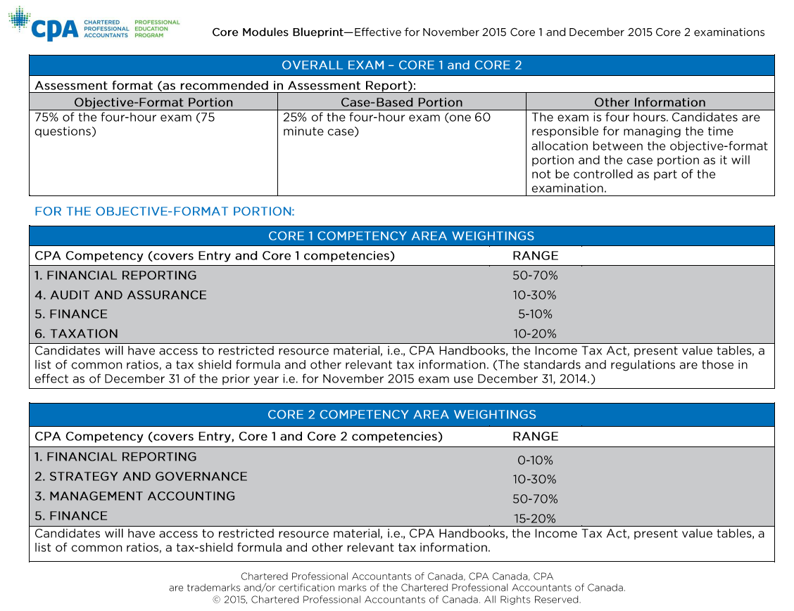
Blue Print – Core 1 and 2

Slide 25
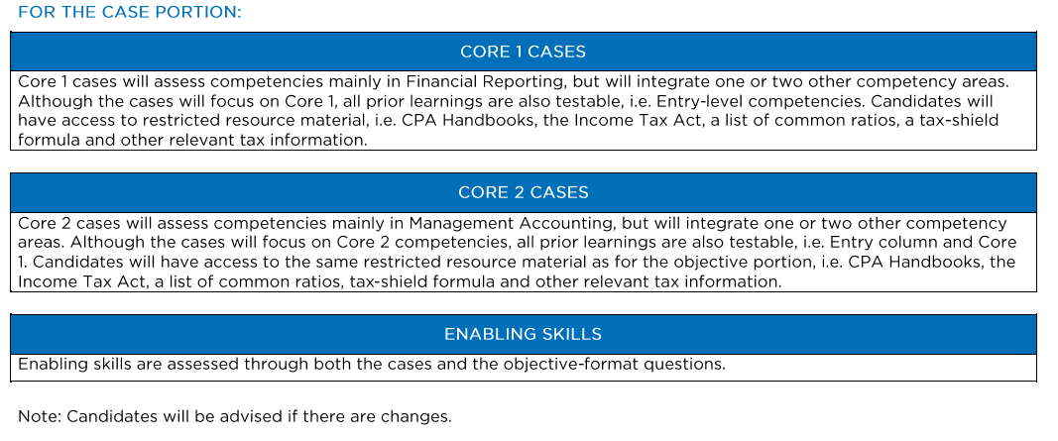
Blue Print – Core 1 and 2 (continued)

Slide 26
Blue Print - Assurance Elective

Slide 27
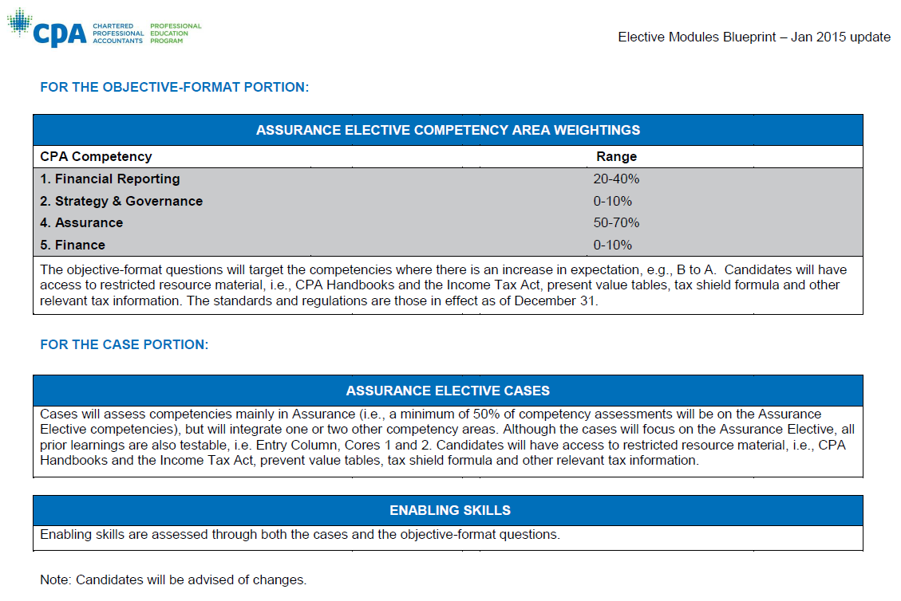
Blue Print – Assurance Elective (continued)

Slide 28
Blue Print - Taxation Elective

Slide 29
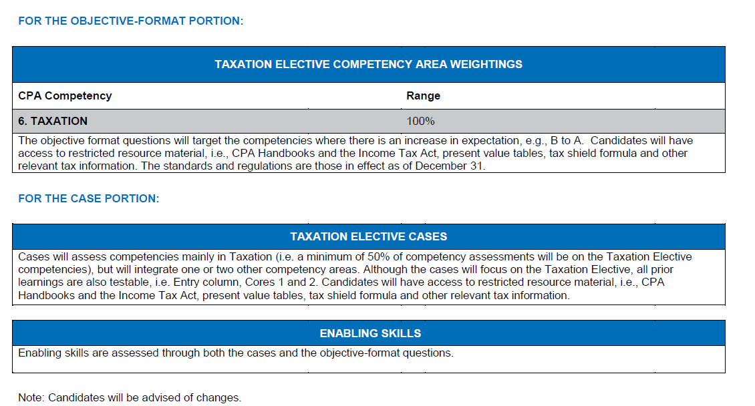
Blue Print – Taxation Elective (continued)

Slide 30
Blue Print - Finance Elective

Slide 31
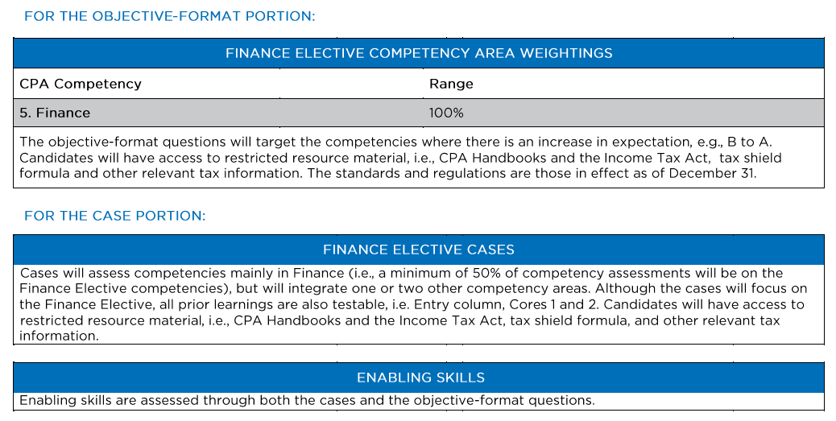
Blue Print – Finance Elective (continued)
Note that only finance tested in objective format questions

Slide 32
Blue Print – Performance Management Elective

Slide 33
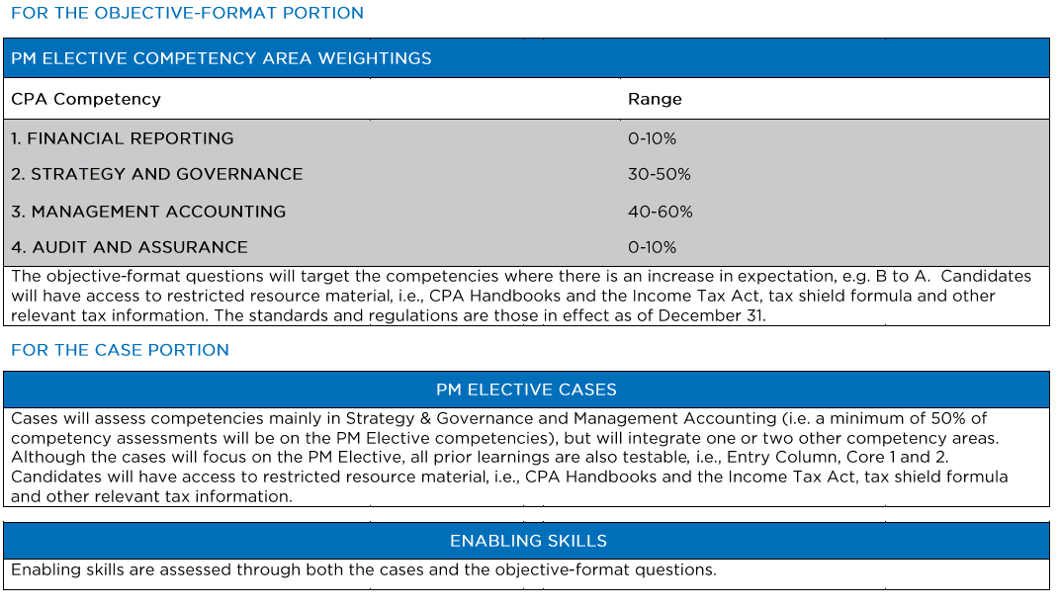
Blue Print – Performance Management Elective (continued)
Note that Management accounting is biggest area
Note that Strategy & Governance and Management Accounting over 50%

Slide 34
Information Session
Timing of Challenge Exams
34

Slide 35
Upcoming Exam Dates
 | Nov 18 2016 | Dec 21/22 2016 | March 30/31 2017 | July 6/7 2017 | Sept 28/29 2017 | Dec 20/21 2017
Core 1 | Core 1 | - | Core 1 | Core 1 | - | Core 1
Core 2 | - | Core 2 | Core 2 | Core 2 | Core 2 | Core 2
Assurance | - | Assurance | Assurance | Assurance | Assurance | Assurance
Taxation | - | Taxation | Taxation | Taxation | Taxation | Taxation
35

Slide 36
Information Session
Preparing for the Challenge Exams and Deciding When to Write
36

Slide 37
Preparing for the Exams
Difficult to give precise number of hours needed to pass exams – will depend upon current level of technical skills
Should focus on 3 things:
Reviewing technical material
Practicing objective format questions – which can also help reinforce technical
Practicing writing cases
Each students is different, so each student needs to come up with a customized study plan

Slide 38
Preparing for the Exams (continued)
Involves laying out on a week by week basis what you would like to accomplish both in terms of technical review/writing objective format questions and writing practice cases
Be realistic – take into account work obligations as well as personal life
Sample study plans for each of the Challenge Exams are available on the PASS website – passyourcpa.ca (under “Resources”)
Study plan prepared in excel so students can tailor the plans to individual circumstances

Slide 39
Deciding When to Write
Students can write the Challenge exams twice – if unsuccessful after two tries need to take modules
Therefore students want to be ready when they write
Once you figure out the approximate time it will take to get ready you can determine which exam sitting to take
No required order for exams – possible to write Core 2 before Core 1 and Electives before the Core exams

Slide 40
Deciding When to Write (continued)
Keep in mind that you cannot write two exams on the same day – be careful in scheduling (see next slide)
Core 1 and Assurance Elective are generally on the same day, with exception of Nov 18, 2016 when only Core 1 is offered and Dec. 21, 2016 and Sept 28, 2017 when only Assurance Elective is offered
Core 2 and Tax Elective are always on the same day
If you are starting work in late September, may wish to try to get all of the exams out of the way before you start, by writing 2 exams in July and 2 exams in September
As Core 1 only offered in July (and not Sept) – should write Core 1 in July

Slide 41
Deciding When to Write (continued)
Synergy exists between Core 1 and Tax Elective given that taxation is examinable on Core 1 - therefore if you write 2 exams over 2 days would suggest writing Core 1 and Tax - for example. Core 1 on July 6 and Tax elective on July 7
In order to write the CFE in September 2017 need to finish Core and Elective exams by March, 2017

Slide 42
PART 2 – PASS PROGRAM
Who is PASS?
42

Slide 43
Who is PASS?
PASS began offering UFE courses in 1989
PASS courses have been offered in all of the large 4 firms – PWC, KPMG, EY and Deloitte and numerous mid-size firms
PASS courses are offered across Canada
Michael Levi, co-director of PASS, former Gold Medalist
Instructors have professional UFE marking experience
Consistent excellent feedback from students

Slide 44
Information Session
PASS
CPA Program
44

Slide 45
CPA PASS Program
PASS will prepare you for all of the Challenge exams:
Core 1
Core 2
Electives
Pass will also prepare you for the CFE
In addition PASS provides resources for students taking modules and Accredited/Diploma Programs

Slide 46
Course for Challenge Exams
15 day Course will:
Review technical knowledge for all of the technical competencies
Teach fundamental case writing skills necessary to attack cases successfully
Provide opportunity for students to write hundreds of practice objective format questions
Allow students to practice their case writing by writing simulated cases for the Core and Elective exams which are debriefed and professionally marked

Slide 47
Course for Challenge Exams (continued)
Many options in terms of timing to suit students writing exams in any sitting
Possible to take portion of course in spring, portion in summer and portion in fall if you are writing exams over the course of several months.
Possible to take only components of the course e.g. Core 2 exam or Taxation exam, but not recommended if you will be writing all of the exams given that the exams test multiple competencies
Please refer to PASS master schedule: http://www.passyourcpa.ca/master-schedule.php for dates for the challenge exams for each of the exam sittings

Slide 48
Course for Challenge Exams (continued)
Course offered either: (1) In-Class
(2) Live Online
(3) Video (watch anytime once uploaded)
Can mix and match – i.e. In-class or/and live online or/and video
Videos available 24/7 for as long as you need them

Slide 49
Resources for Students Taking Modules
Modules generally do not provide a comprehensive technical review
PASS therefore provides extensive technical resources to supplement the modules and help students improve their chances of passing
Both study materials and videos available
Materials and videos include concise summaries of technical material as well many hundreds of multiple choice and other types of objective format questions that can be used to both master the technical material and practice for the exam
Possible to purchase a study binder/video package that covers multiple competencies or individual competencies

Slide 50
Resources for Students Taking Modules
Practice cases also available for module exams
Gives students an opportunity to gain an edge by writing additional cases on top of cases written in module
Information on technical and case writing material available on the PASS website:
Technical Material: http://www.passyourcpa.ca/technical-resources-module-students.php
Practice Cases: http://www.passyourcpa.ca/case-writing-resources.php

Slide 51
Resources for Students Taking Accredited/Diploma Program
Courses and other resources provided for students in Accredited/Diploma programs as many diploma students do not feel adequately prepared for CFE – also often these course are over a year before the CFE so lots of time to forget material
Technical course and case writing course available
Technical course provides a review of all of the competencies
Case writing course provides opportunity to write practice cases which are marked professionally and debriefed
Courses available live and through video
Students can also purchase technical resources

Slide 52
Resources for Students Taking Accredited/Diploma Program (cont.)
Information on technical and case writing courses and technical material available on the PASS website
Courses: http://www.passyourcpa.ca/pass-courses.php#course_group_5
Technical Resources: http://www.passyourcpa.ca/technical-resources-accredited-program-students.php

Slide 53
PASS Courses for CFE
PASS Courses to Complement Capstone 2
CFE Comprehensive Course – includes practice case writing and “technique” sessions
(2) Financial Act’g. IFRS/ASPE Review Course
(3) Management Act’g. Review Course

Slide 54
Courses for CFE (continued)
Specialized Courses
CFE Course for Indian/Pakistan CAs

Slide 55
Courses for CFE (continued)
Comprehensive Course – Practice Case Writing
5 days
Course includes:
1 day dedicated to techniques for achieving depth on CFE
Write (and get marked) 5 multi simulations
Write (and get marked) 2 comps
4 multi simulations and 2 comps de-briefed
1 personal counselling session (for one exam)
PASS comprehensive binder and all course notes
Detailed Marking Guide Publication

Slide 56
Courses for CFE (continued)
Comprehensive Course - Technique Sessions – 4 days
Technique Sessions
Numerical Methods – Learn how to perform quantitative analysis quickly and effectively
Depth in Financial Accounting - Essential technique for financial accounting issues which ensures students will move from 'nominal' or 'reaching' competent to 'competent‘
Integrated Audit – learn audit techniques to achieve depth in assurance
Integrated Tax – Review corporate and personal tax and integrate technical into cases
The Integrated Audit sessions is for students who did not do the PASS Challenge Exam Course

Slide 57
Courses for CFE (continued)
Financial Accounting IFRS/ASPE Course – 3 Days
In-depth review of financial accounting
Publication – Financial Accounting Technical Review
Course offered – In-class and live online
All sessions available on video
This course is particularly useful for students who did not take the PASS Challenge Exam Course

Slide 58
Courses for CFE (continued)
Management Accounting Course – 6 Evenings
In-depth review of management accounting
Course offered – live online
All sessions available on video
This course is particularly useful for students who did not take the PASS Challenge Exam Course

Slide 59
Courses for CFE (continued)
Courses Provide for Maximum Flexibility
Courses offered:
In-Class:
Live Online:
All sessions on video – available 24/7
Students can switch between in-class and live online sessions

Slide 60
Courses for CFE (continued)
Why take PASS if taking Capstone 2?
More Feedback Needed
In Capstone 2 - Limited number of exams written and marked; PASS will provide you with more opportunities to write cases that are marked professionally and hone your case writing abilities – will give you an edge
PASS will allow you to meet one on one with marker and learn how to improve your case writing

Slide 61
Courses for CFE (continued)
(2) Case Take-ups
PASS – Learn the PASS approach to debrief both multis and comps
Debrief 2 comps and 4 multi simulations
(3) Learn key techniques to get enough depth to excel on CFE

Slide 62
Courses for CFE (continued)
Do I have time to take PASS when taking Capstone 2?
YES – Capstone 2 is a time commitment of approx. 10 – 15 hours per week
Capstone 2 is designed for people who work full time in the summer months

Slide 63
Registration for PASS Programs
Registration – Current Program
To register for PASS courses visit the PASS website: passyourcpa.ca and register online
Admission to courses is on a first come first serve basis so register as early as possible
Not required to be registered with CPA Ontario before registering with PASS

Slide 64
Contact Information
For Inquiries:
Contact: Michael Levi mjlevi@passyourcpa.ca 416-224-9400
Ira Walfish iwalfish@passyourcpa.ca 416-224-9929

Slide 65
Twitter - @pass_cpa & Blog
Twitter
Follow us on twitter: @pass_cpa
We will be regularly updating you with new developments / course specific issues
PASS Your CPA Blog
Join the conversation on our website, passyourcpa blog
Read about current developments and concerns of students

